Slide 1

The MFA Member Website
An Introduction

Slide 2
This presentation will provide a tour of the contents and possibilities of the MFA member website. Then, it will take you through the steps of accessing the secure site with an ID and password.

Slide 3
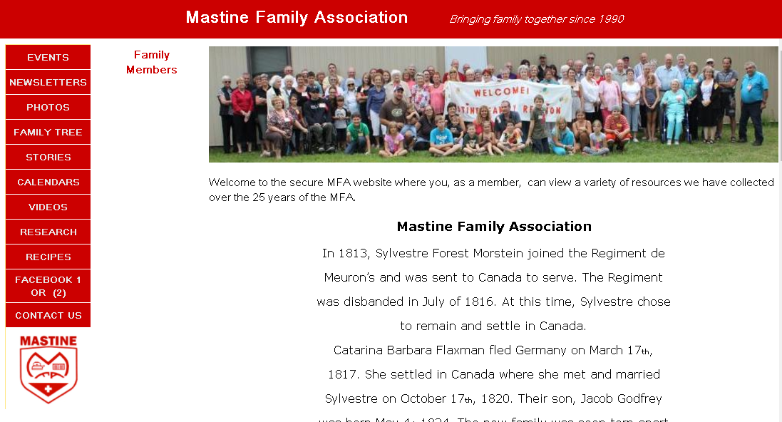
This is the site

Slide 4
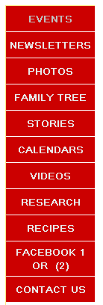
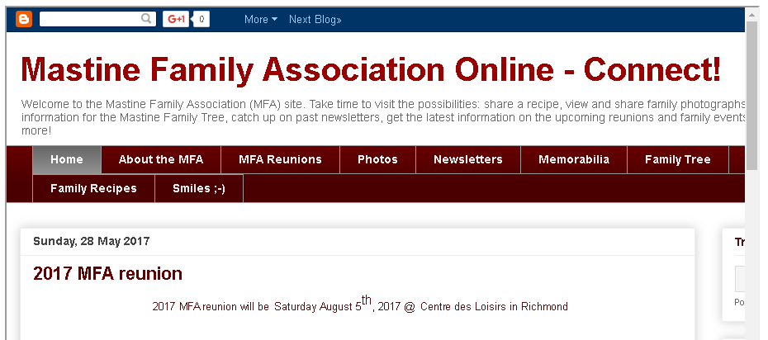
So let’s explore:
Events take you to the public Blog for the latest reunion news and any other news & info the MFA shares since 2011:

Slide 5
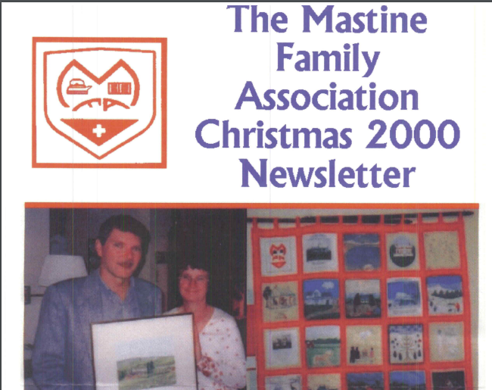
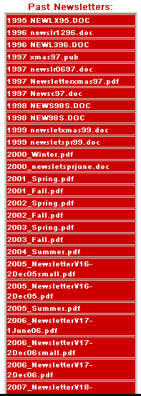
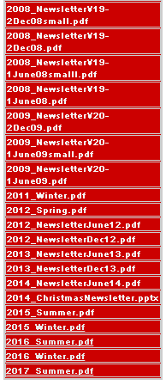
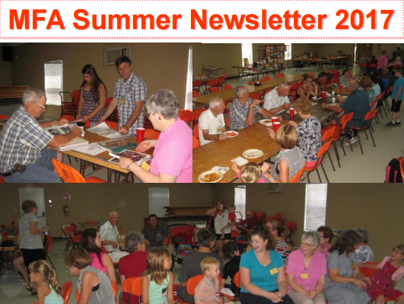
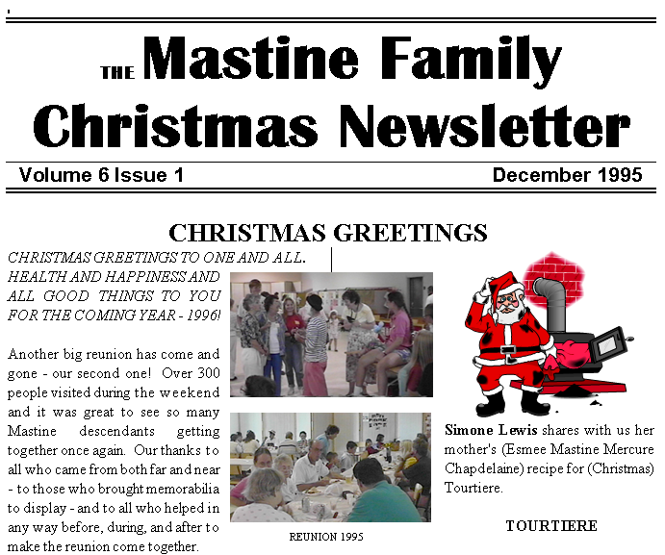
News letters : An archive of all the present and past newsletters since 1995. Scroll down, Choose, Click and Enjoy!

Slide 6
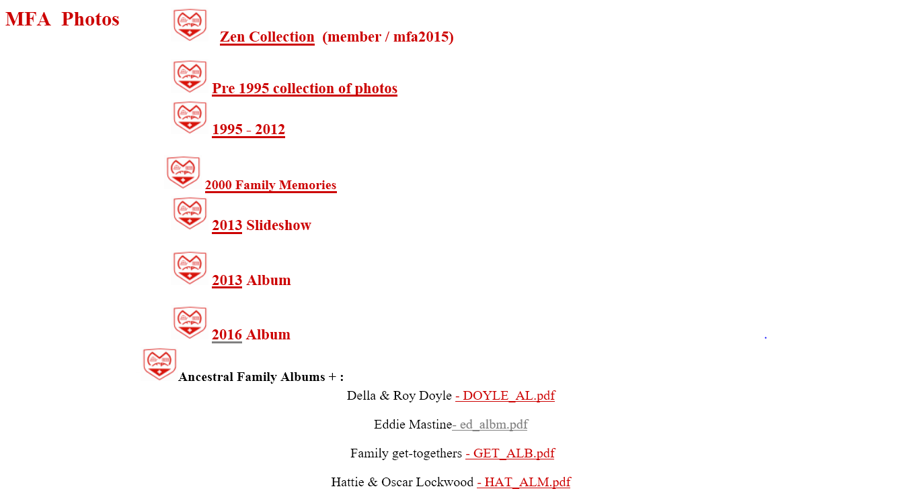
Photos:
A complete bank with log in access -Older heritage photos
Reunion flashbacks
Families in 2000
2013 highlights
2016 memories
Photos of ancestors

Slide 7
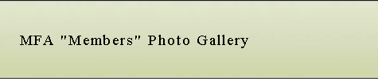
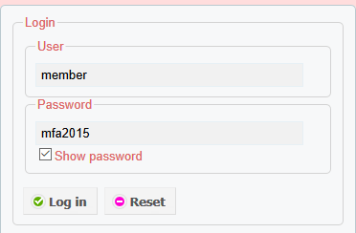
Zen Collection:

Slide 8
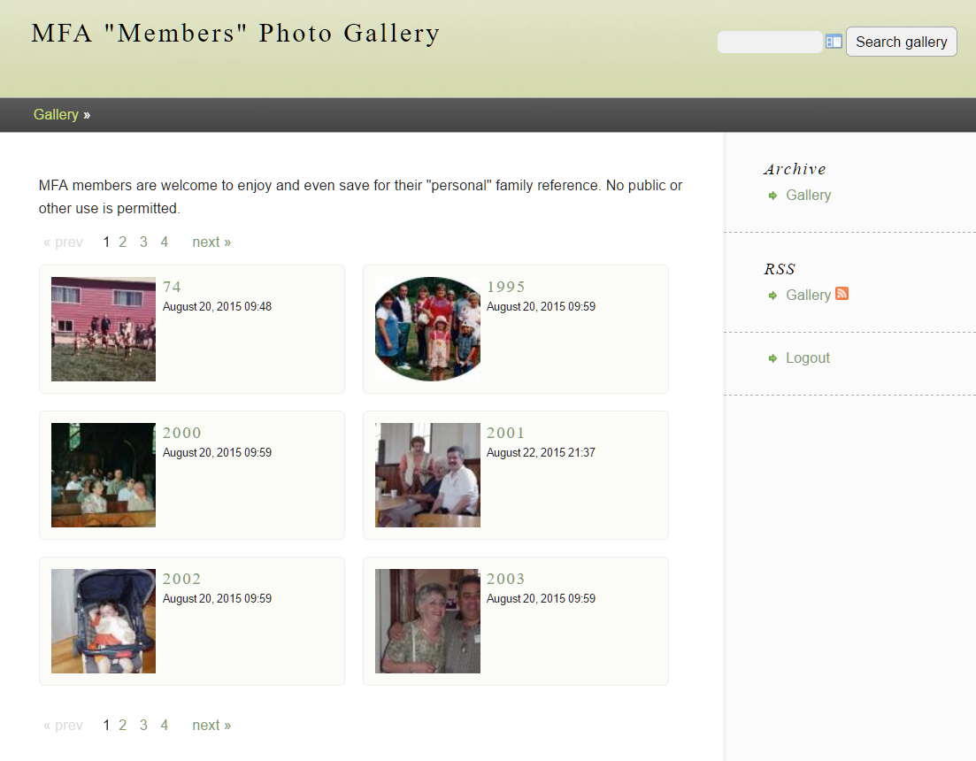
Zen Collection
member
mfa2015

Slide 9
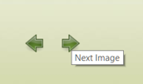
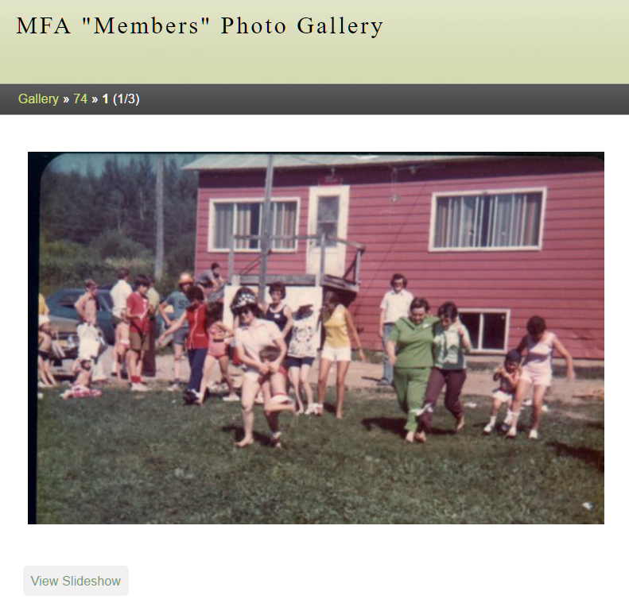
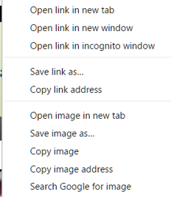
Zen Collection
View
Choose a slideshow
Right click on mouse and save or copy

Slide 10
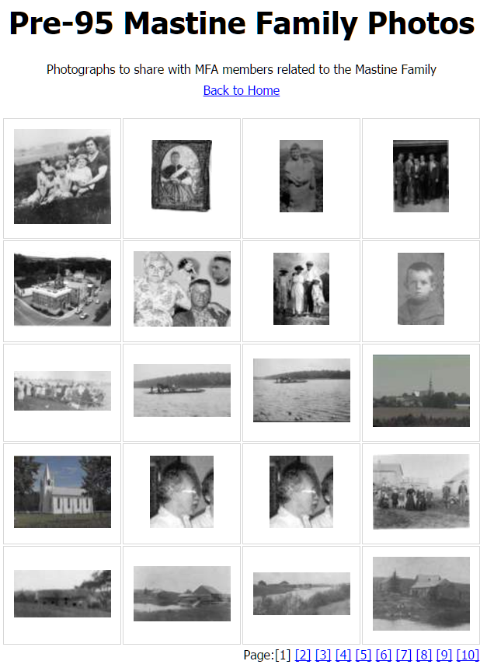
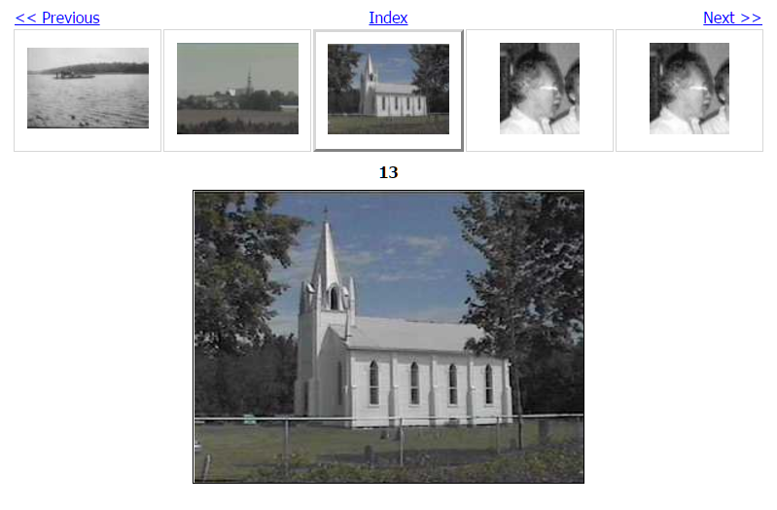
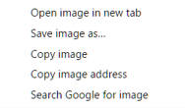
Pre 1995
Click and navigate / right click to save

Slide 11
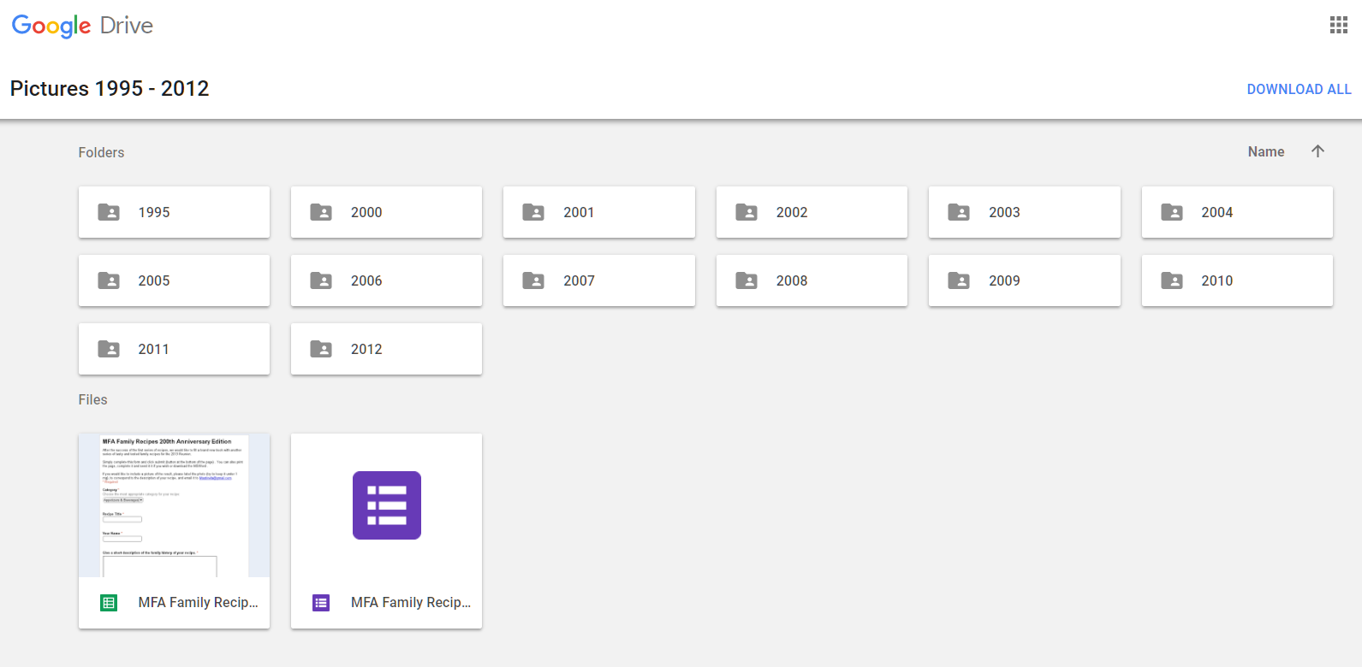
1995 – 2012 Photos From Past Reunions

Slide 12
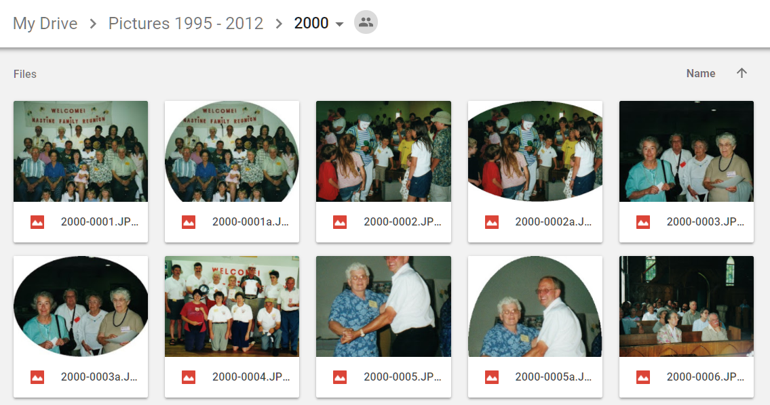
Choose a year… Choose a Photo…

Slide 13
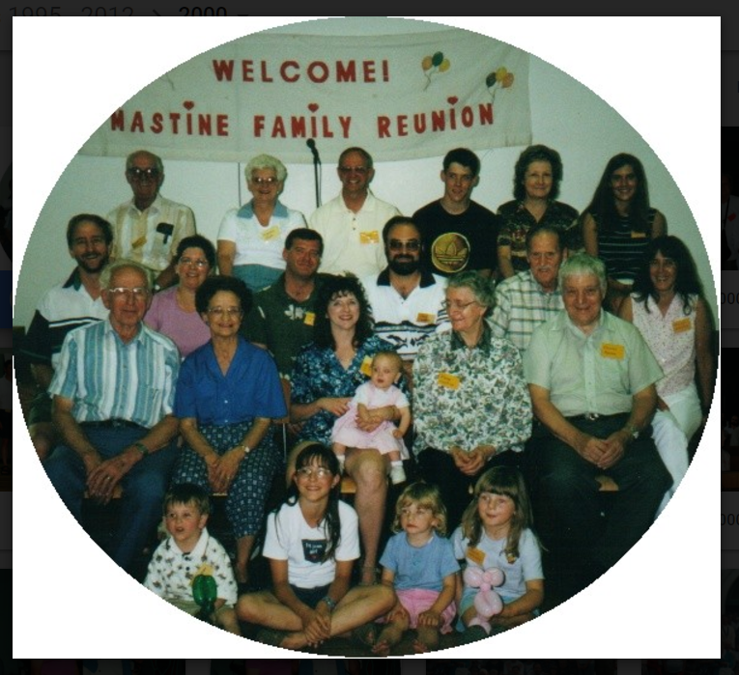


Double Click :
To enlarge
Navigate with the side arrows
Open, print, etc. with the top black menu

Slide 14
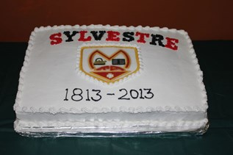
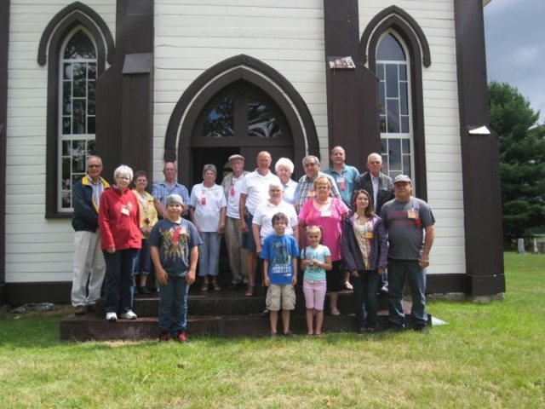
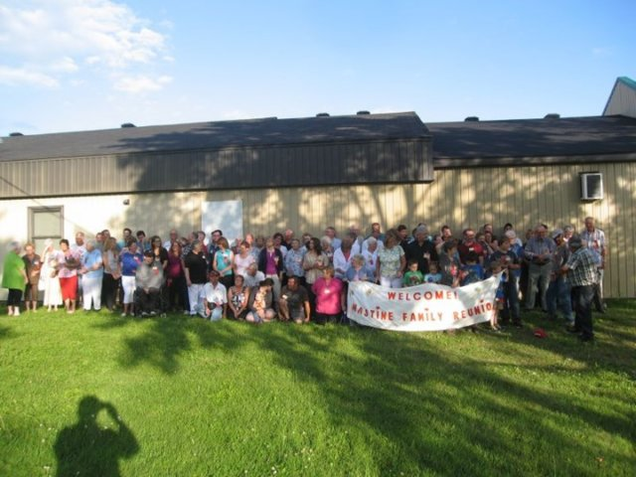
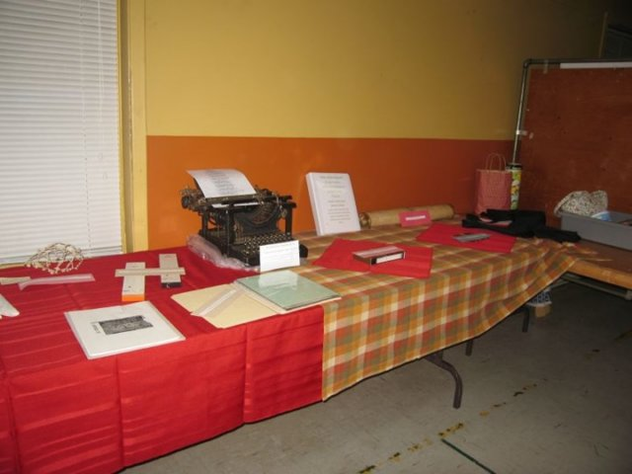
2013 200th Anniversary in North America: Photo slideshow
Automatic slideshow of MFA activities commemorating 200 years in Canada.

Slide 15
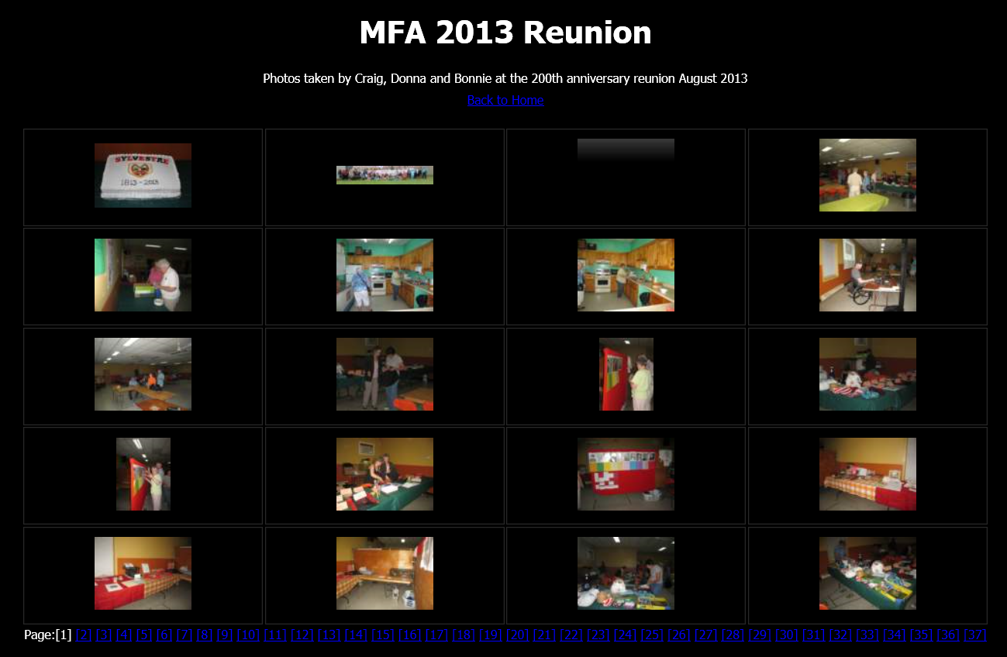
2013 200th Anniversary in North America: Photo Album
Click an image

Slide 16
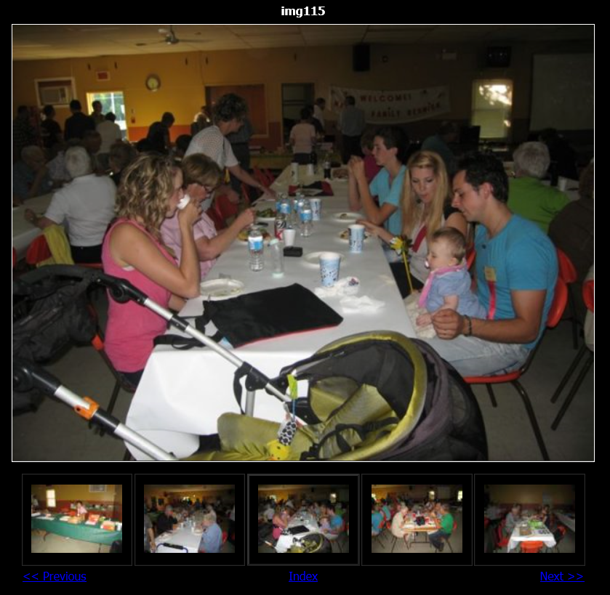
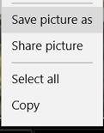
2013 200th Anniversary in North America: Photo Album
Choose the links
to navigate
Right click (PC) to save, copy, etc.

Slide 17
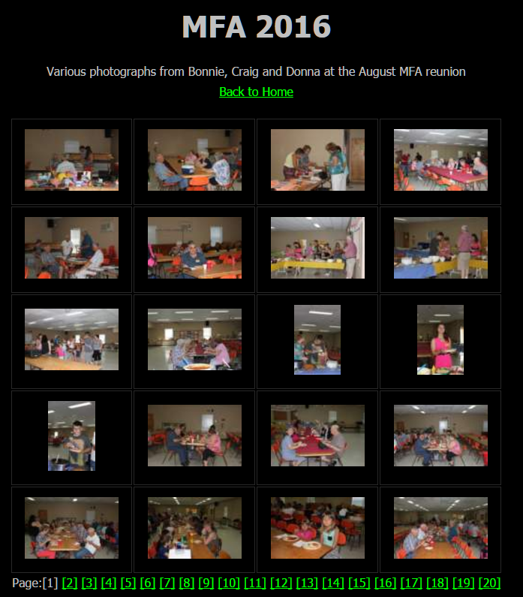
2016 Album
Photo collection from the 2016 MFA reunion

Slide 18
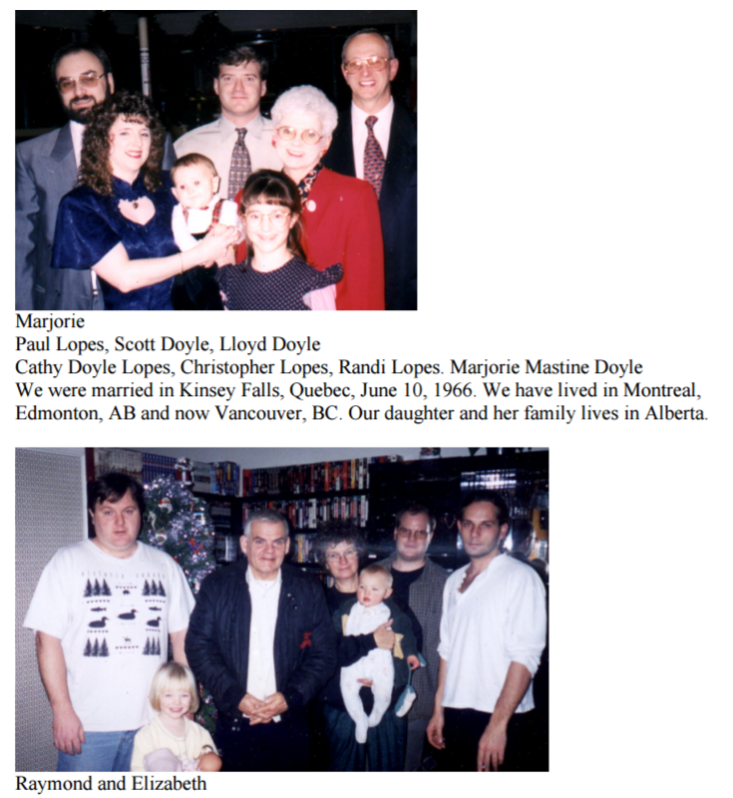
2000 Family Memories
View the pictures and notes shared in the 2000 MFA Book.

Slide 19
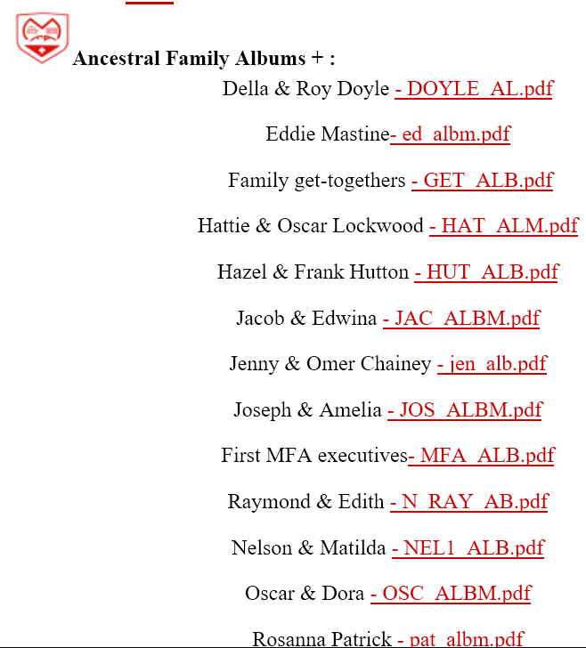
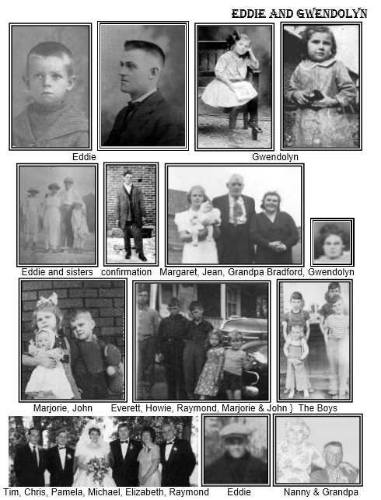
Family Ancestors Photo album
As seen in the MFA Family History Books.

Slide 20
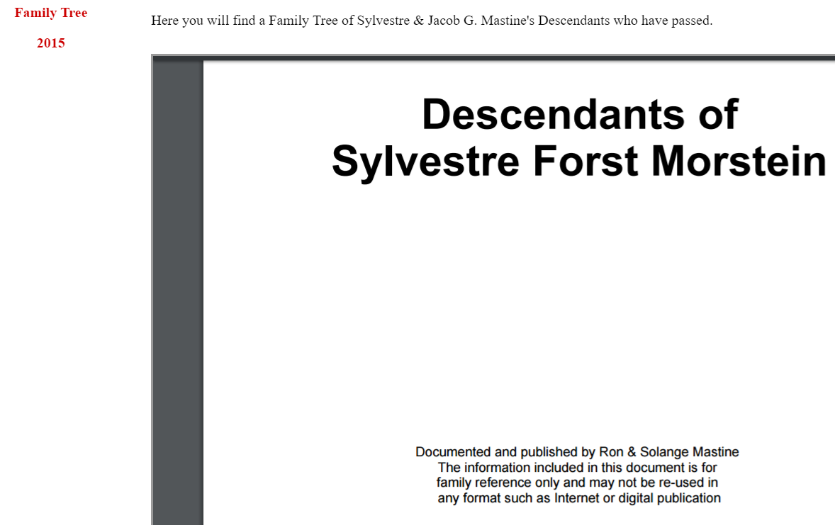

Slide 21
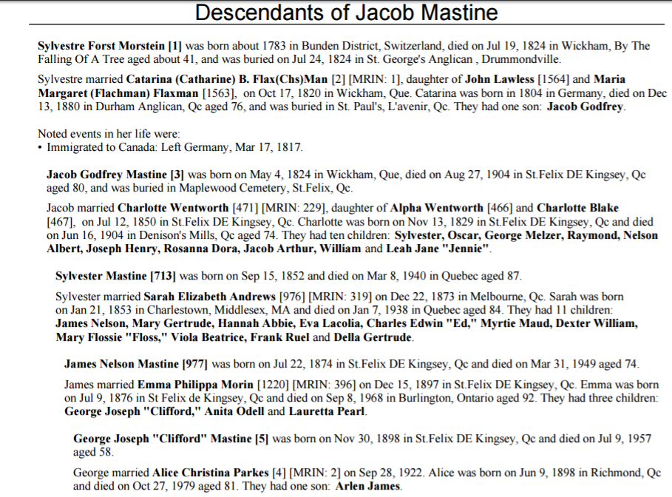
Scroll Down

Slide 22
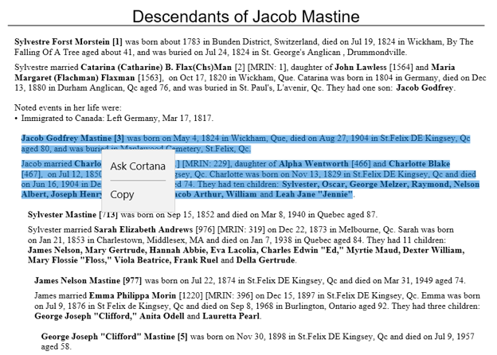
To Copy: select text and right click to choose copy (PC)- Open a document and Paste.

Slide 23
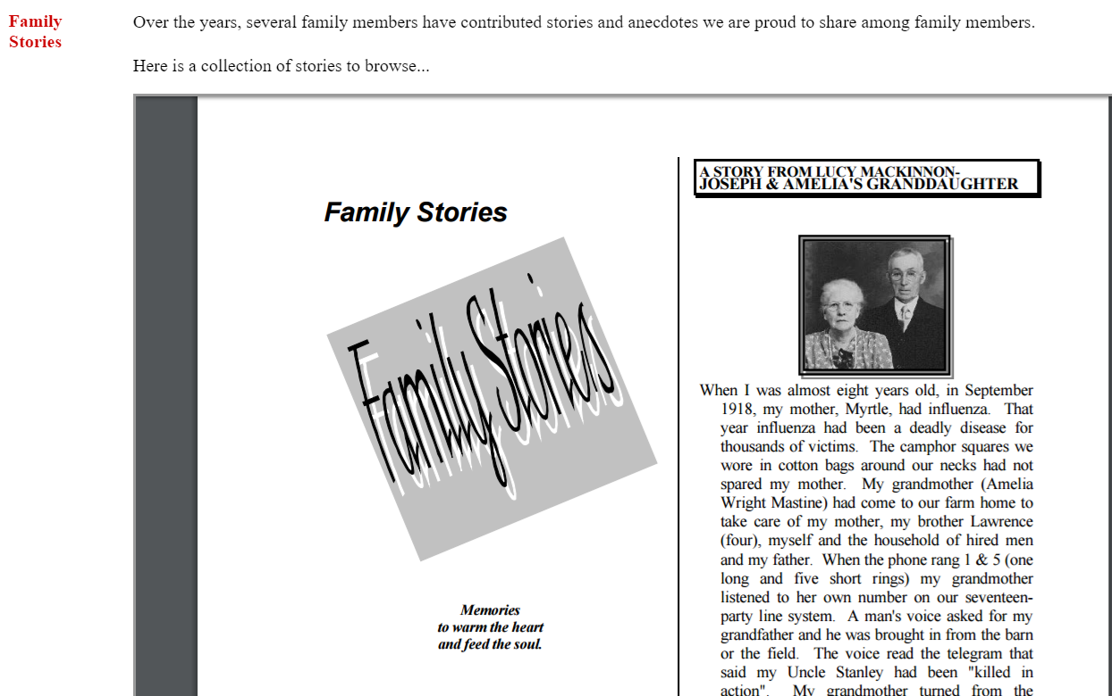
Family Stories
Scroll Down

Slide 24
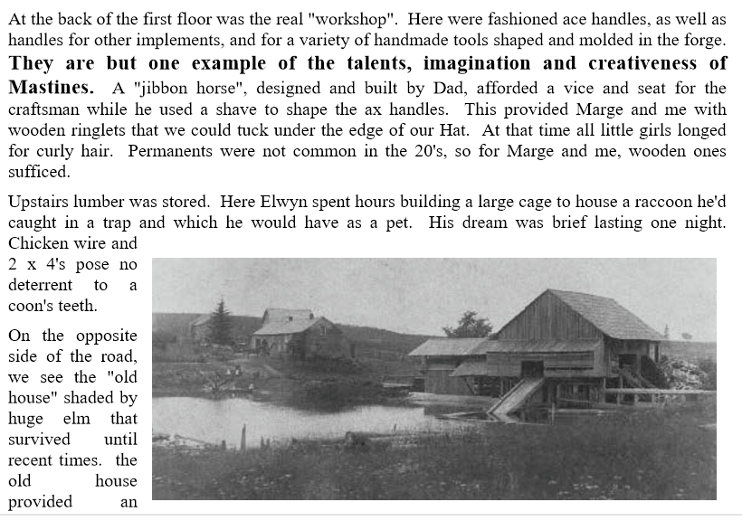
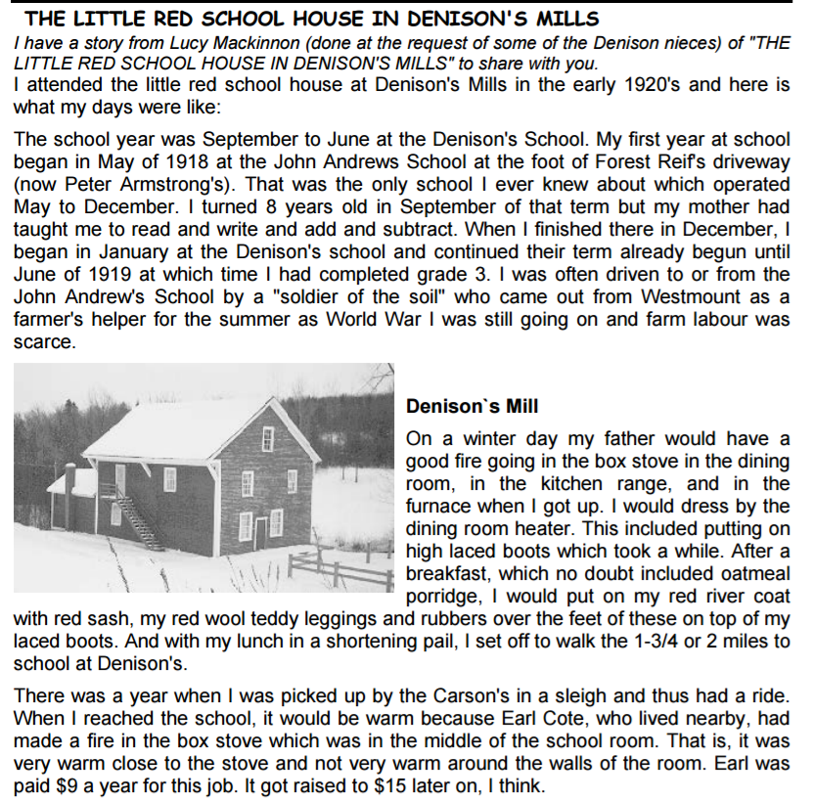
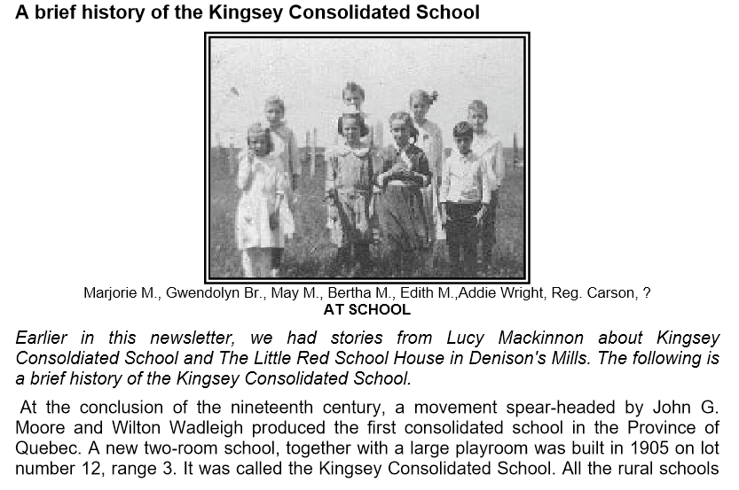
More… 1- 50
Family Stories

Slide 25
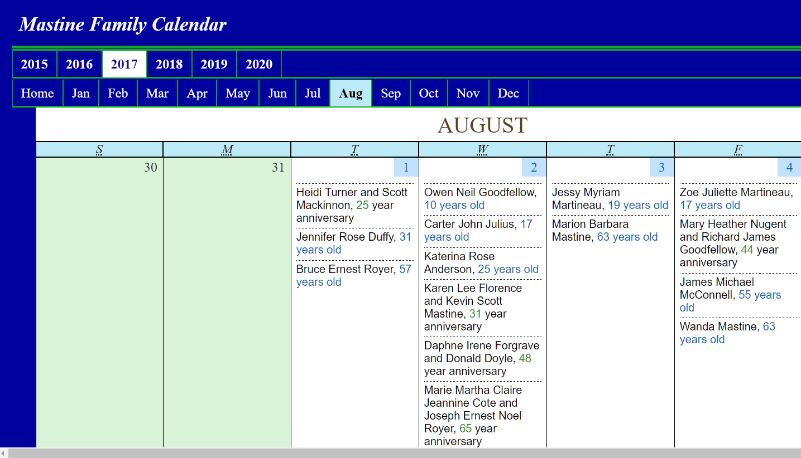
Created in 2015: The calendar covers until 2020 but things happen… Click the year and month to view most details – See the age /anniversary

Slide 26
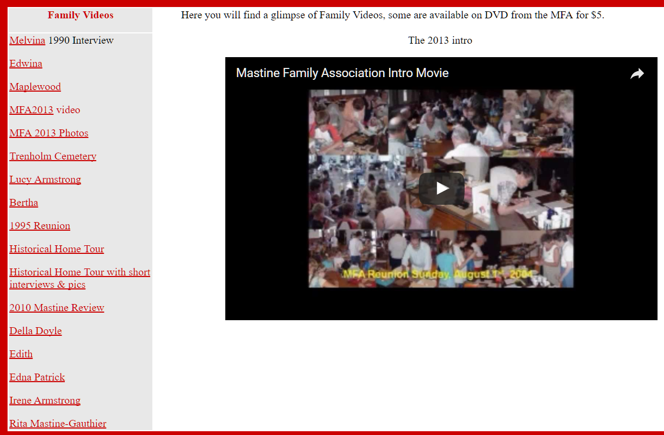
Family Videos
Just CLICK
CLICK ON A VIDEO AND THEN, CLICK THE ARROW

Slide 27
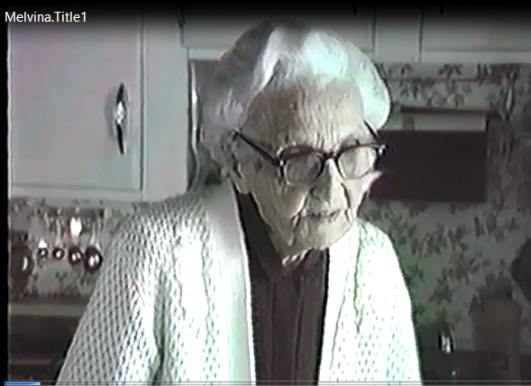
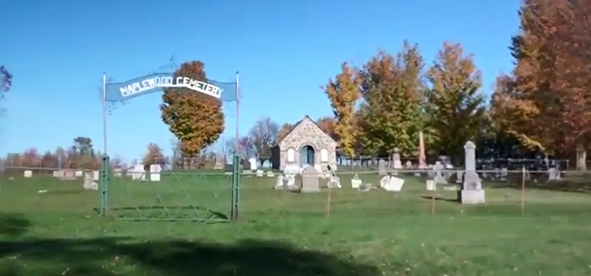
Videos online… Click to View.
MaplewoodCemetery.mp4
Melvina/Melvina.mp4 Etc.

Slide 28
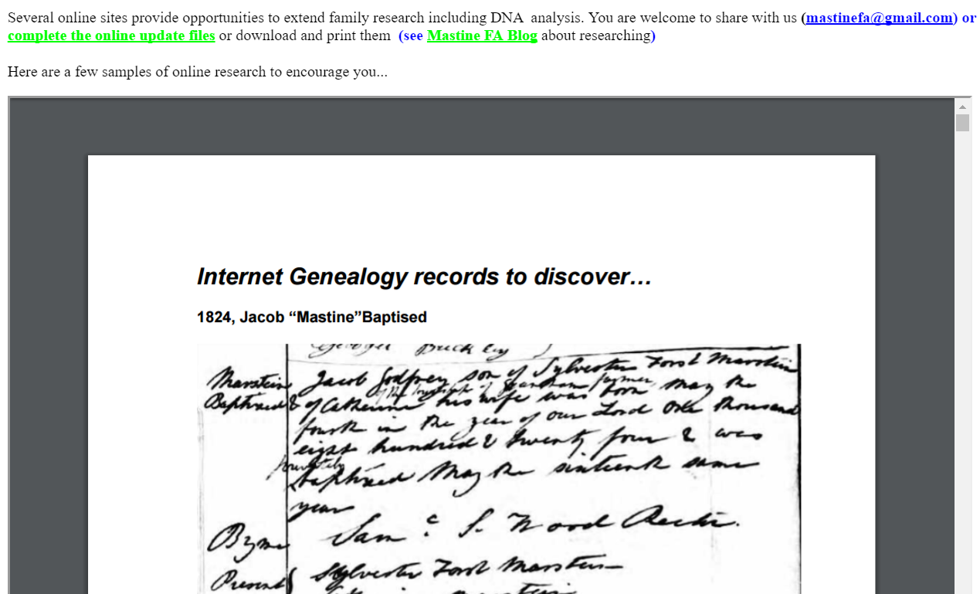
Research suggestions: to get the info you want!

Slide 29
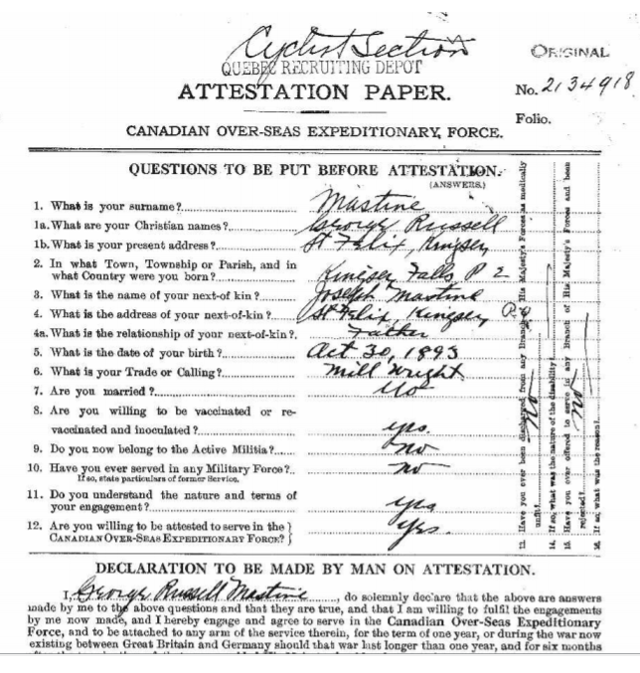
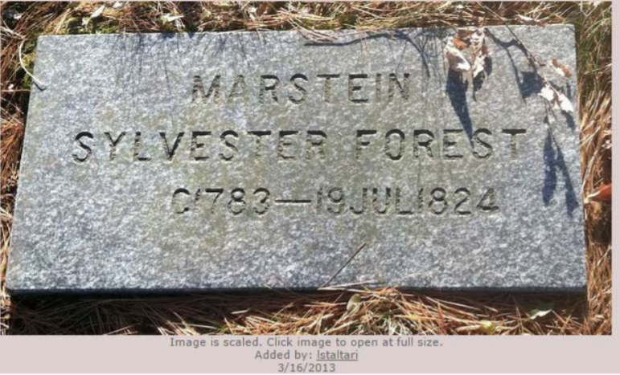
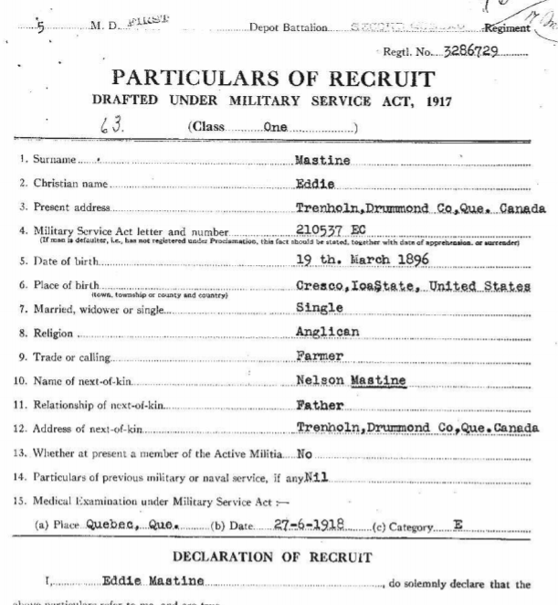
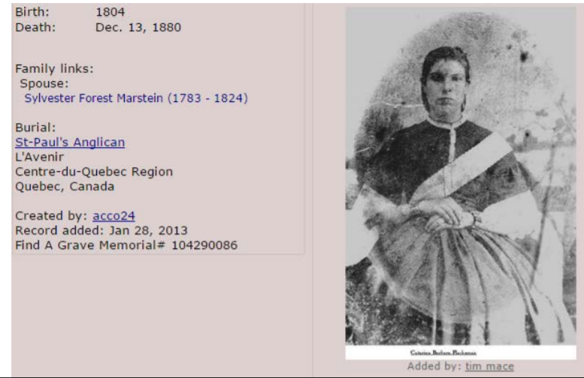
Research finds…

Slide 30
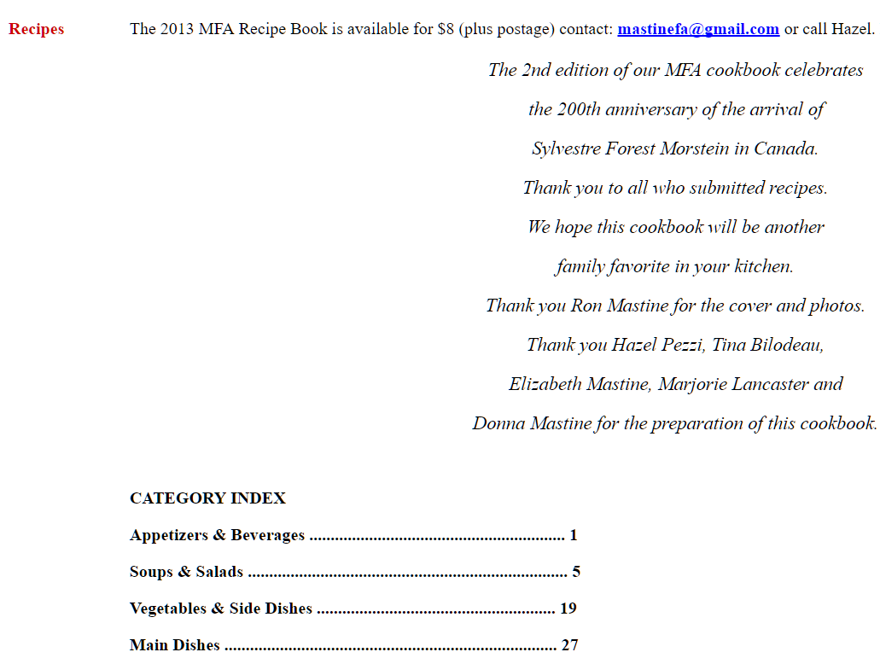
Recipes
Recipes

Slide 31
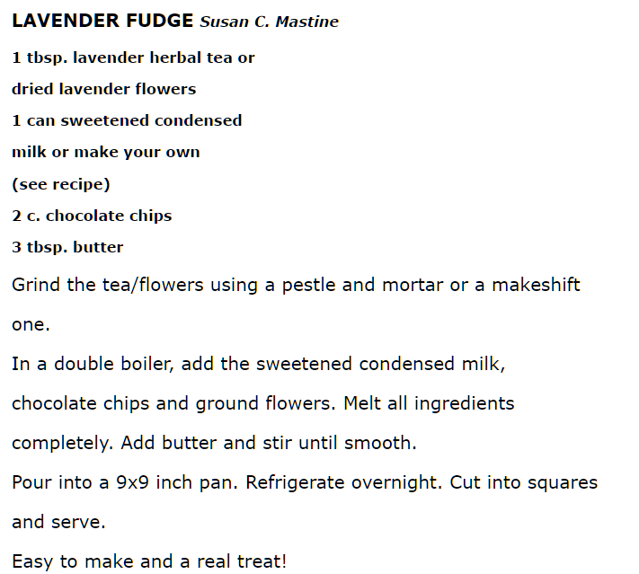
Recipes:
An example

Slide 32



Facebook
Offerings:
(1)-page with posts
From 127 members

Slide 33


Facebook
Offerings:
(2)-page with photos

Slide 34



Slide 35

Now, we will look at accessing the website
When you first visit the site you will want to go to the site using a link {http://mfa.mastweb.net } or by typing the link in the address box of the Internet browser you use; Edge, Firefox, Internet Explorer, etc.

Slide 36

This is what you will see on the welcome page:
The page includes a link to member login, the MFA email and the open MFA blog shows up below.
The MFA blog is open to the World but not the Member Website!!

Slide 37
So how do you get into the MFA Member site?
If you are a member and would like access, contact Ron at mastinefa@gmail.com for your password.
For today, we have set up a special password for you to try out the website. – 17 - exactly like that … no capitals – no space.
mfa

Slide 38


So how do you get into the MFA Member site?
Click on the top of the page.
This little box will pop up – in User Name: write member - no capital letters

Slide 39
So how do you get into the MFA Member site? (2)
After you have written User Name: member - no capital letters
Now write in the password you have been given exactly as it was written in the email you were sent.
Today’s : mfa17 ( no capitals)
Now – click Log In

Slide 40
You are in the site, Enjoy…

Slide 41
Let us know your comments and suggestions
Updates to your family information can be sent via email:
mastinefa@gmail.com
or an online form :
http://mastinesonline.blogspot.ca/p/tree-updates.html
these links are in the MFA newsletters and sites
Visit often and participate!

Slide 42
The MFA Member Website
Thanks for your interest in the MFA Private Website
By Ron Mastine for the MFA
mfa.mastweb.net

Slide 43

Check out the Free Blog – available to all.
Continue to preview the MFA Blog!
mastinesonline.blogspot.com

Slide 44

mastinesonline.blogspot.com
MastineFA@gmail.com

Slide 45

2013
200 years in North America

Slide 46
http://mastinesonline.blogspot.com/
MastineFA@gmail.com

Slide 47
Welcome to the Mastine Family Association (MFA) Blog. Take time to visit the possibilities:
share a recipe,
view and share family photographs,
update your family information for the Mastine Family Tree,
catch up on past newsletters,
get the latest information on the upcoming reunions and family events,
order family memorabilia and more!

Slide 48

All part of the Mastine connection

Slide 49

Home
About the MFA
MFA Reunions
Photos
Newsletters
Memorabilia
Family Tree
Tree Updates
Family Recipes
Smiles ;-)
MastineFA@gmail.com

Slide 50



Slide 51


Search the MFA blog site
Subscribe (RSS feed – reader)
posts (news…)
comments by visitors
Follow by email
Followers – list of …

Slide 52


Slide 53


Slide 54

Facebook Photo page
Google Picasa Web Albums
Tags - label the photos

Slide 55


Slide 56

Scan, save as a .jpg or .png image and upload!

Slide 57

Tags identify the people, relationship, place and time!

Slide 58

PICASA
Free
WEB ALBUMS

Slide 59

Leave a comment that others can add to or continue the comments.

Slide 60
Newsletters
Members are sent 2 newsletters with family information and history each year.
We have an archive that can be shared upon appropriate request for members.

Slide 61

Listing of available souvenirs

Slide 62

A little info, a little fun about our family tree!

Slide 63

50 of over 248 places associated with the Mastine Family Connection

Slide 64

So much to discover, thanks to the internet…

Slide 65

Yours to discover…

Slide 66

Take a few minutes to update, correct or share your family connections online.
A simple form to click and complete in order to insure we have the exact information you wish to share with the family.

Slide 67

Participate in another MFA recipe book with this online form.
Don’t forget to check out the ”blonde cookbook”.

Slide 68
An example recipe!
Desserts
Chocolate-Peanut Butter-Marshmallow Drops
Donna Mastine & Jacob Morin (son)
This is a recipe from Kraft Foods Canada Inc. that I came across about 10 years ago. It was so simple to make and so delicious that we have been making it ever since for our many family events during the year.
6 Baker's Semi-Sweet Chocolate Squares (cut in half)
3/4 cups Crunchy Peanut Butter
3 cups miniature Marshmallows
"Melt the Baker's semi-sweet chocolate squares with the peanut butter in a glass bowl in a microwave for 3 mins on medium temperature. Stir until smooth. Should the chocolate not be completely melted continue heating in the microwave for 30 secs to 1 min more.
Let the mixture cool for a few minutes then add in the marshmallows.
Drop by spoonfuls on a cookie sheet covered in waxed paper.
Cool in the frig until firm. Enjoy.
Store the rest in the frig in a closed container.
Yields approximately 2- 3 doz."
Serves 12
10 minutes or less
3- 4 min in a microwave medium temperature

Slide 69

For your entertainment…
Family related chuckles

Slide 70
Visit and participate at:
mastinesonline.blogspot.com
MastineFA@gmail.com

